Slide 1
Analysis on financial profile & default insights

Slide 2
Team members
Tirtho Das 2023-1-60-052
Faria Tasnim Era 2023-1-60-080
Mishal Ibne Mashud 2022-3-60-053
Saba Tasnim Khan 2022-3-60-049

Slide 3

Why is it important?

Slide 4
The Dataset
Have 9 columns
Numerical features include age, employment years, address, income, debt-to-income ratio, credit debt & other debt
Education level is categorical ordinal data encoded numerically
Default status is binary

Slide 5
The Dataset
Dataset is imbalanced

Slide 6
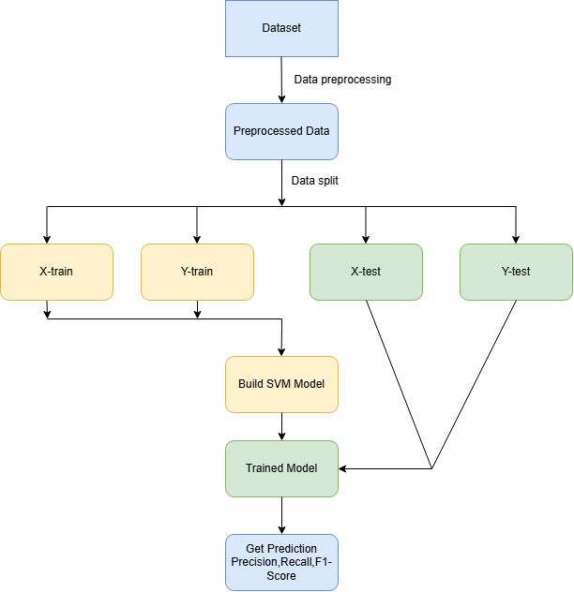
Workflow
Data Preprocessing
Data Splitting
Model Training
Model Evaluation

Slide 7
Result & analysis

Slide 8
Evaluation and Analysis
Confusion Matrix Overview
High Precision for Default Class
Very Low Recall
Low F1-Score
Conservative Default Predictions
Most Defaults Missed
Model Needs Recall Improvement
Explore Class Balancing or New Models

Slide 9
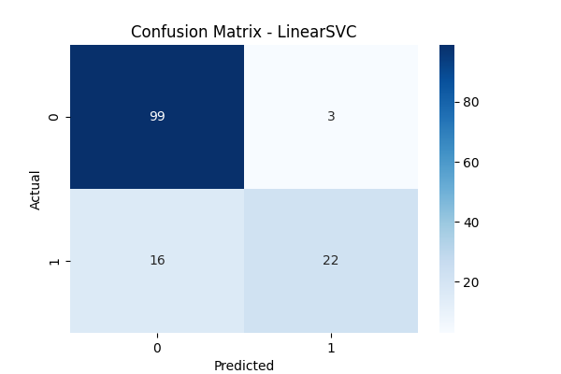
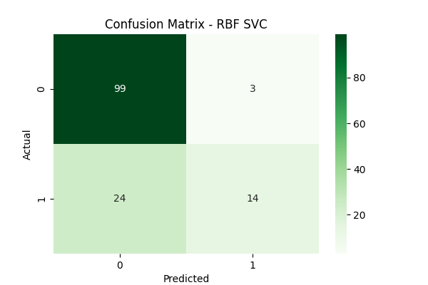
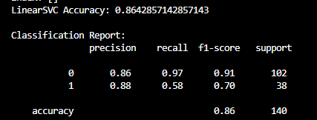
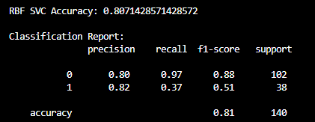
Evaluation and Analysis

Slide 10
conclusion
Compared RBF SVC and LinearSVC for loan default prediction
Both models showed high overall accuracy
RBF SVC achieved high precision but very low recall
LinearSVC failed to detect any defaults
Highlights challenge of class imbalance in real-world data
Model choice significantly impacts performance on minority class
Future improvements: resampling, cost-sensitive learning, tuning, and ensemble models
Predictive modeling supports better credit risk decisions

Slide 11

Thank you

